Slide 1
Polynomials
Integrated mathematics

Slide 2
Objectives
Students will classify polynomials by number of terms and by degree.
Students will add and subtract polynomials.

Slide 3
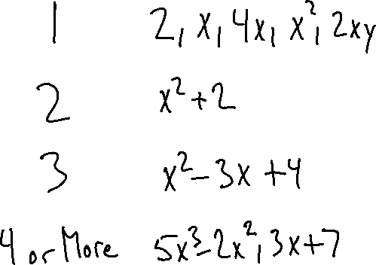
Types of Polynomials
Name | # Terms | Example
Monomial
Binomial
Trinomial
Polynomial

Slide 4
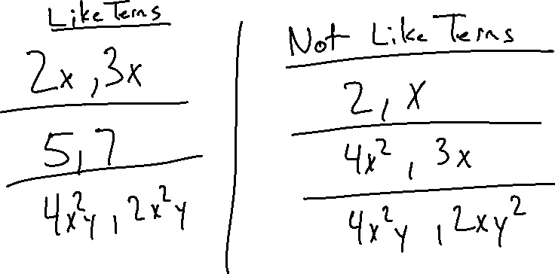
Like Terms
Same Variable
Same Exponent

Slide 5
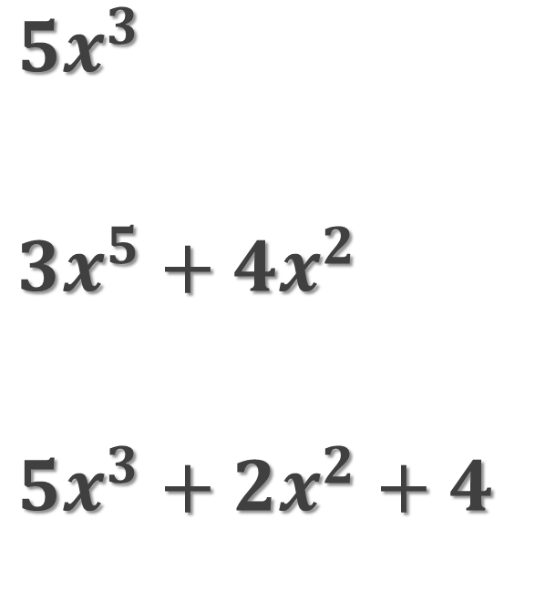
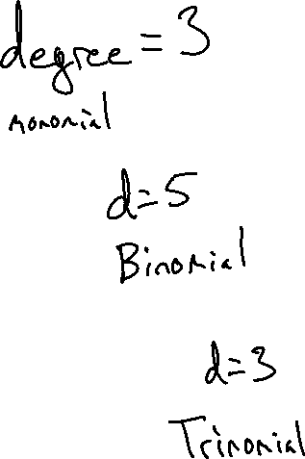
Degree: Largest Exponent on Polynomial
$5x^{3}$
$3x^{5}+4x^{2}$
$5x^{3}+2x^{2}+4$

Slide 6

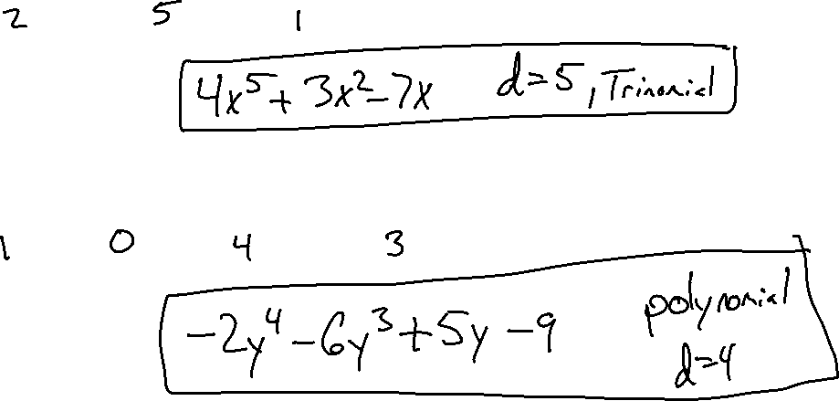
Descending Order: Highest Degree First
$3x^{2}+4x^{5}−7x$
$5y −9−2y^{4}−6y^{3}$

Slide 7
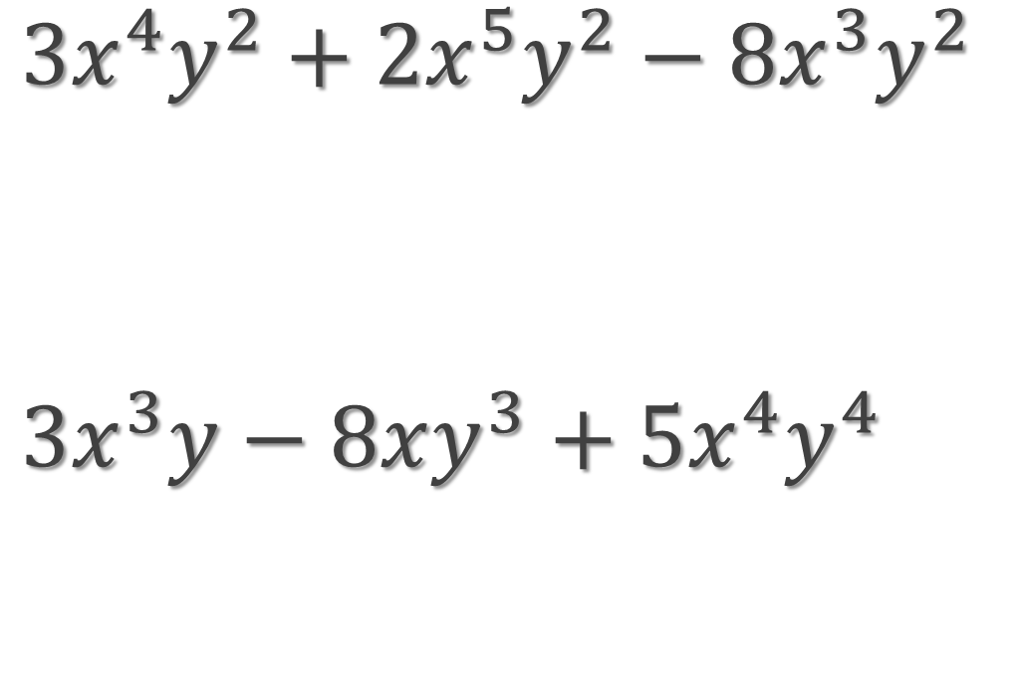
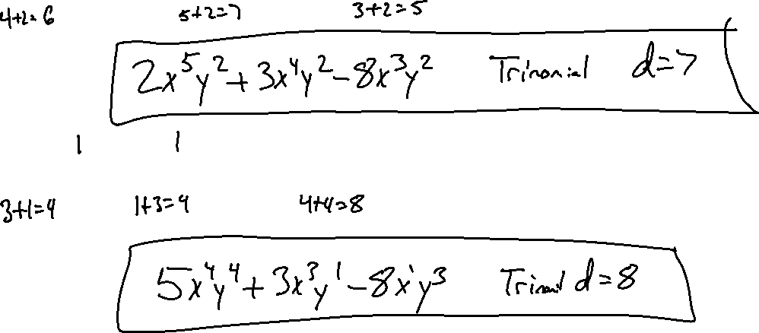
Descending Order:
$3x^{4}y^{2}+2x^{5}y^{2}−8x^{3}y^{2}$
$3x^{3}y−8xy^{3}+5x^{4}y^{4}$

Slide 8
POLYNOMIAL ADDITION
Stack Like-Terms and Circle Terms without a Match
Combine Like-Terms
Put Simplified Terms in Descending Order

Slide 9
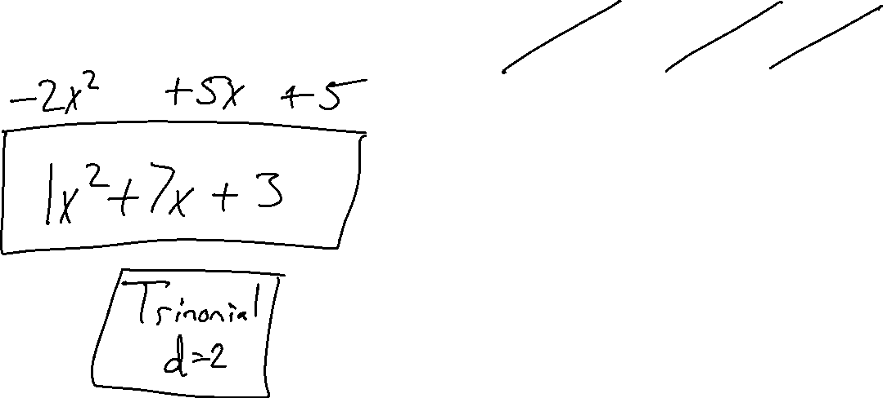
Example 1
$$\left({3x}^{2}+2x−2\right)+({−2x}^{2}+5x+5)$$

Slide 10
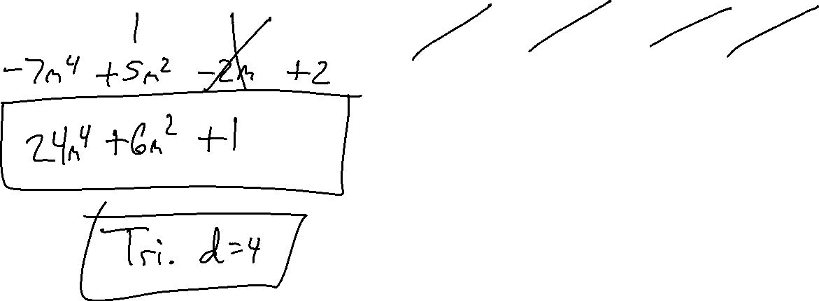
Example 2
$$\left({31m}^{4}+m^{2}+2m−1\right)+({−7m}^{4}+{5m}^{2}−2m+2)$$

Slide 11
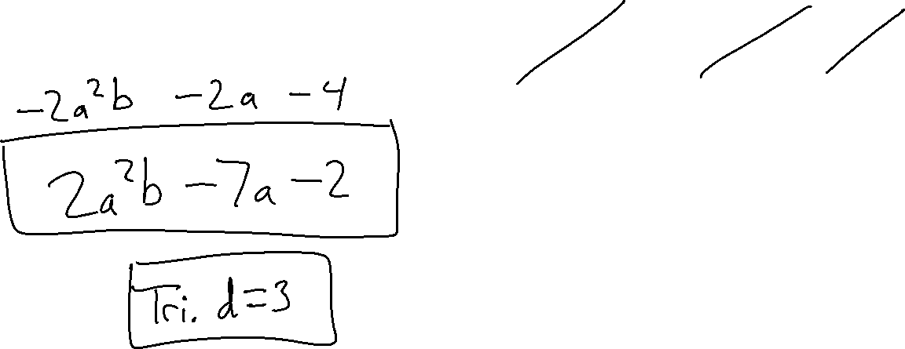
Example 3
$$\left({4a}^{2}b−5a+2\right)+({−2a}^{2}b−2a−4)$$

Slide 12
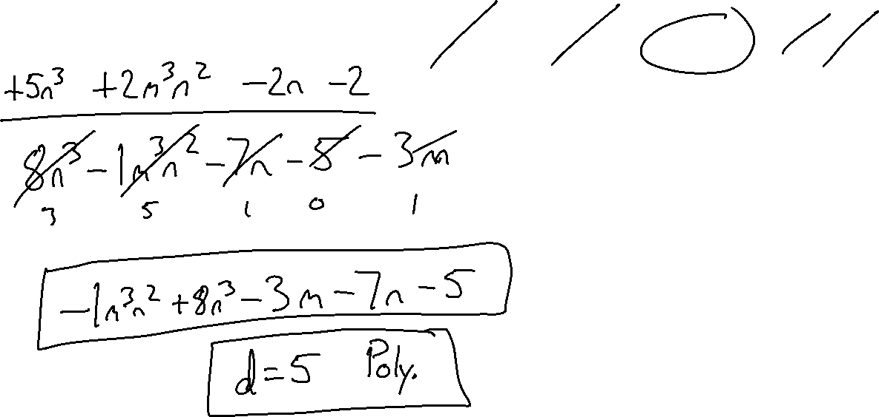
Example 4
$$\left({3n}^{3}−{3m}^{3}n^{2}−5n−3\right)+({5n}^{3}+{2m}^{3}n^{2}−3m−2n−2)$$

Slide 13
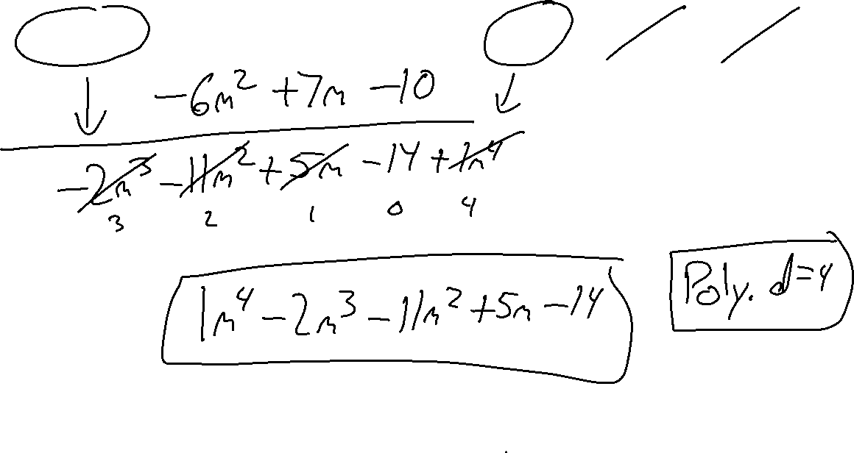
Example 5
$$\left({−2m}^{3}−{5m}^{2}−2m−4\right)+(m^{4}−{6m}^{2}+7m−10)$$

Slide 14
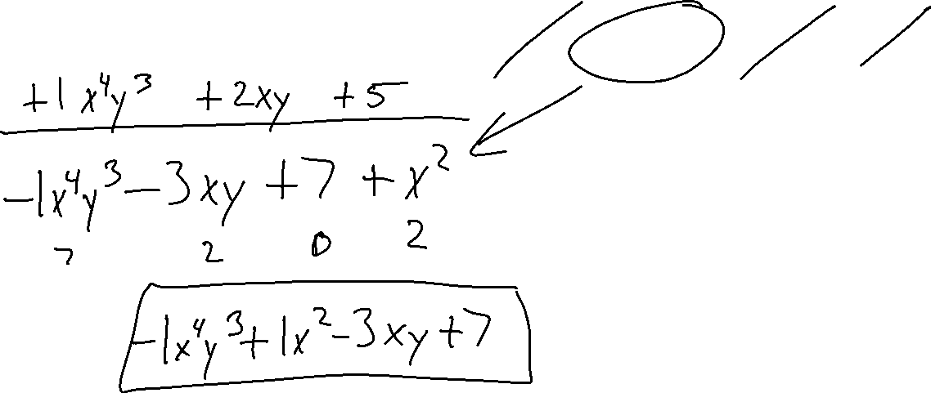
Example 6
$$\left({−2x}^{4}y^{3}−5xy+2\right)+(x^{4}y^{3}+x^{2}+2xy+5)$$

Slide 15
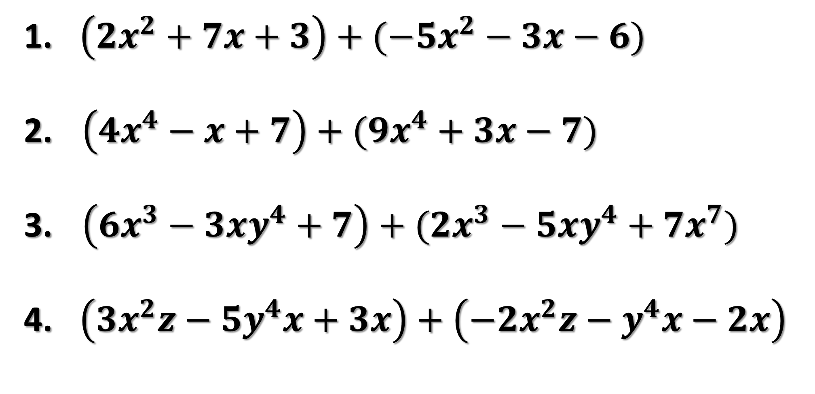
Try on your own
$\left({2x}^{2}+7x+3\right)+({−5x}^{2}−3x−6)$
$\left(4x^{4}−x+7\right)+(9x^{4}+3x−7)$
$\left(6x^{3}−3xy^{4}+7\right)+(2x^{3}−5xy^{4}+7x^{7})$
$\left(3x^{2}z−{5y}^{4}x+3x\right)+\left(−2x^{2}z−y^{4}x−2x\right)$

Slide 16


POLYNOMIAL SUBTRACTION
Change to a and Change Signs in Second
Parenthesis (Distribute the Negative Sign)
Stack Like-Terms and Circle Terms without a Match
Combine Like-Terms
Put Simplified Terms in Descending Order

Slide 17
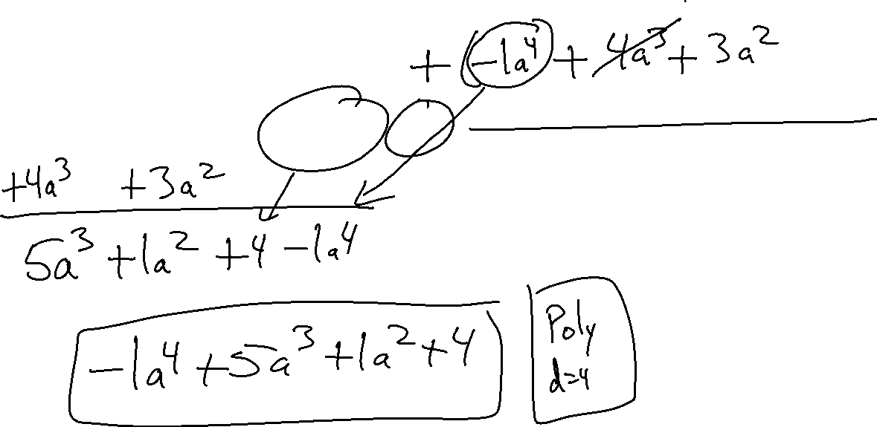
Example 7
$$\left(a^{3}−2a^{2}+4\right)−(a^{4}−4a^{3}−{3a}^{2})$$

Slide 18
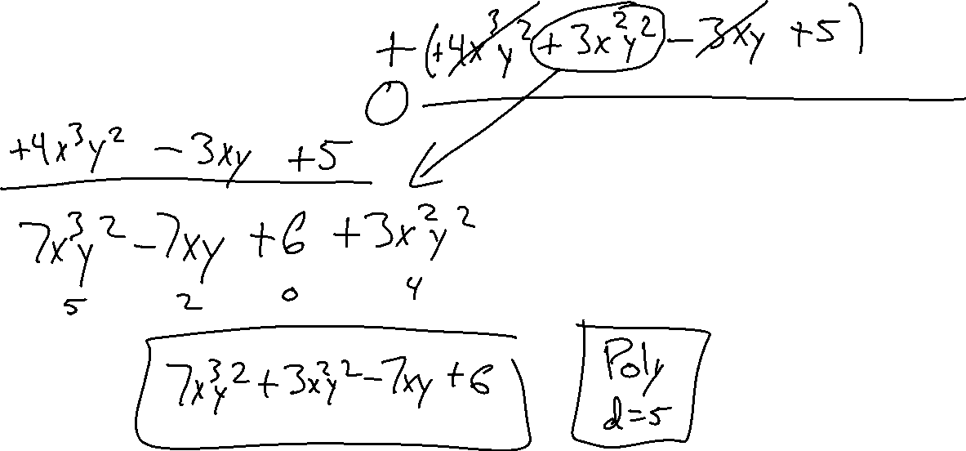
Example 8
$$\left({3x}^{3}y^{2}−4xy+1\right)−(−4x^{3}y^{2}−3x^{2}y^{2}+3xy−5)$$

Slide 19
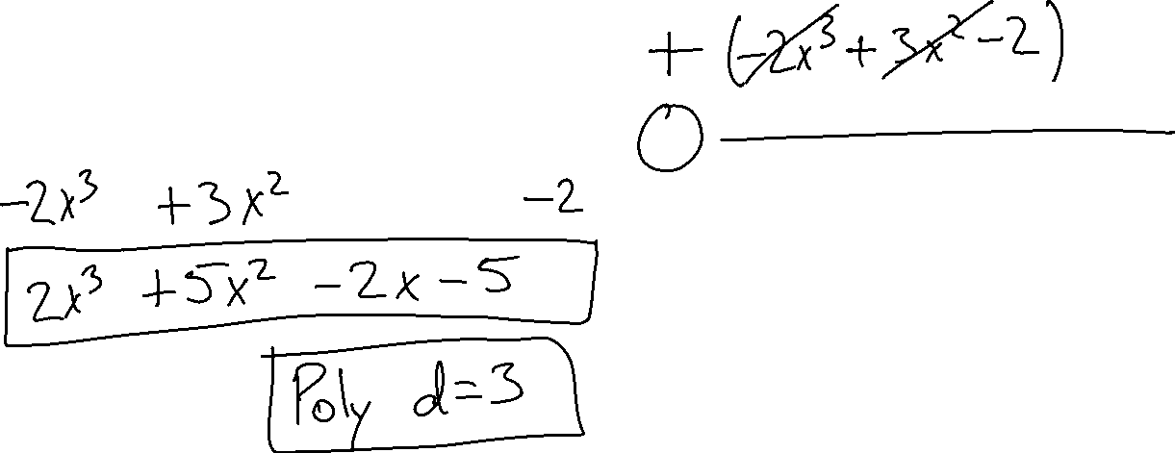
Example 9
$$\left(4x^{3}+2x^{2}−2x−3\right)−(2x^{3}−3x^{2}+2)$$

Slide 20

Ticket out the door
$\left({2x}^{2}+7x+3\right)−({−5x}^{2}−3x−6)$
$\left(3x^{2}z−{5y}^{4}x+3x\right)−\left(−2x^{2}z−y^{4}x−2x\right)$
Rate Yourself +, -, or o

